Slide 1



Feature matching and model fitting

Slide 2
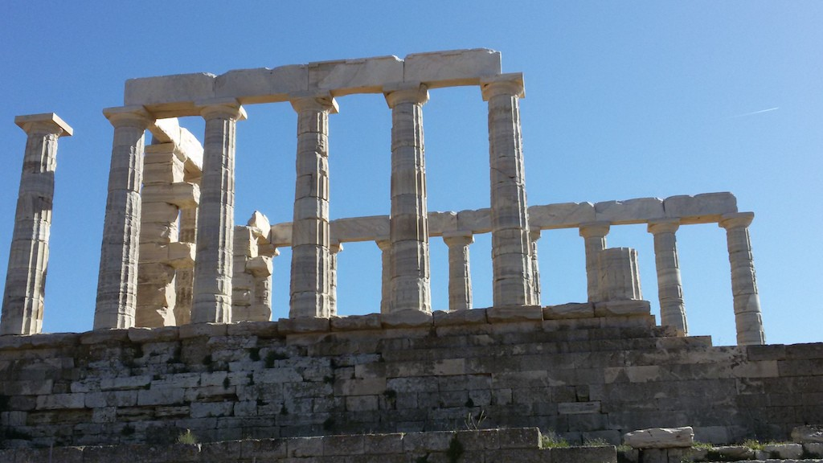
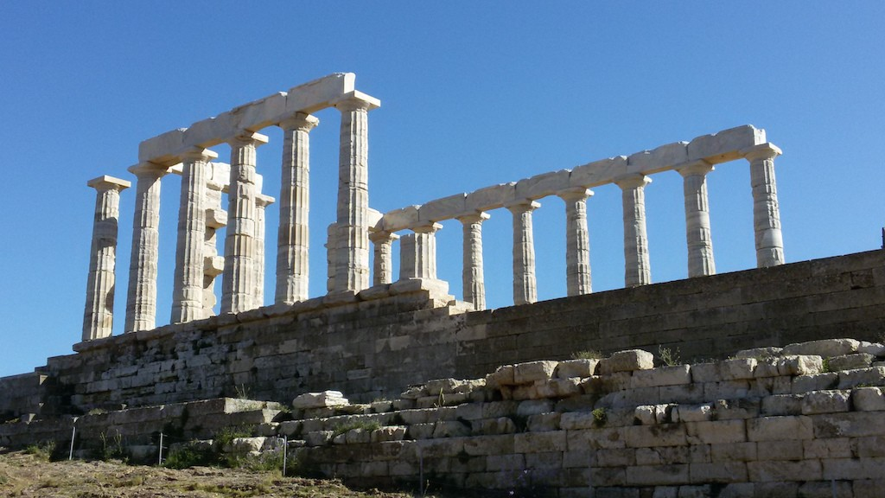
Can you get the 3-D structure of the scene?
Get a set of pairs of corresponding points.
Compute fundamental matrix.
Derive camera matrices.
Solve for 3-D coordinates of scene points for each pair of corresponding points.

Slide 3
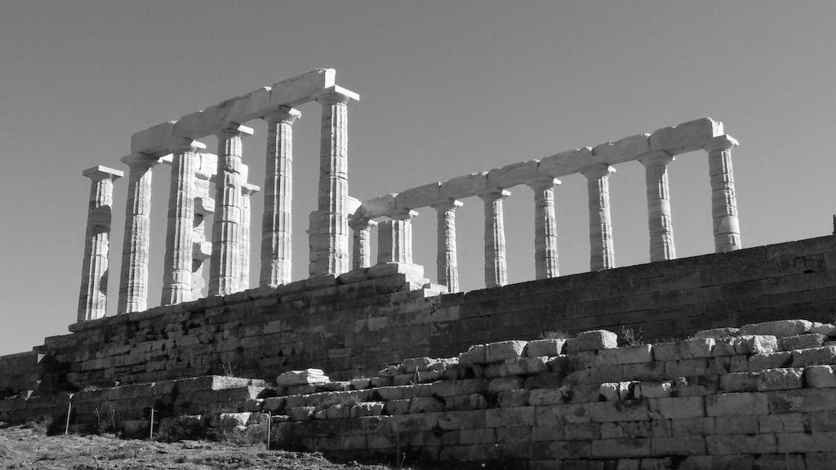
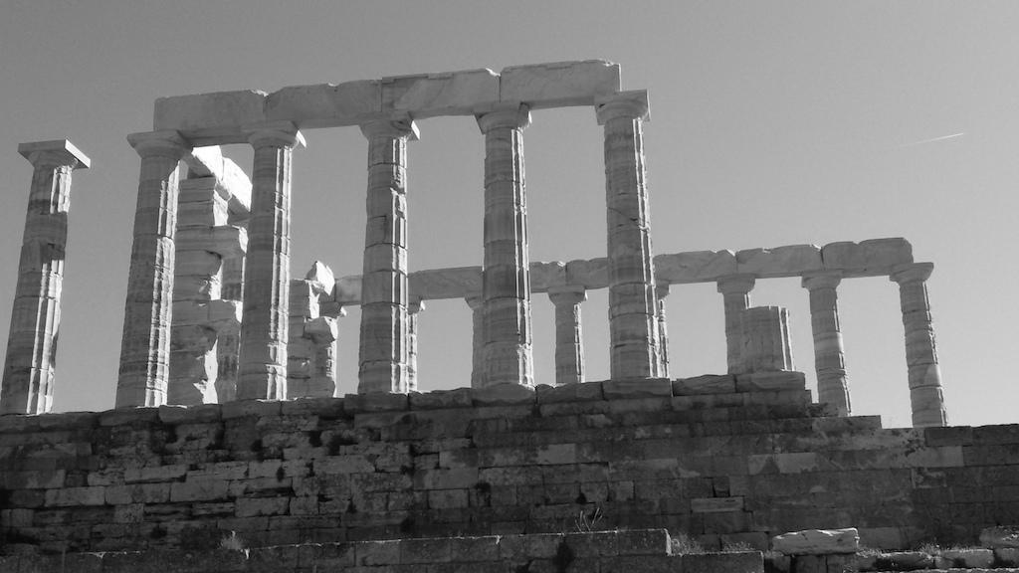
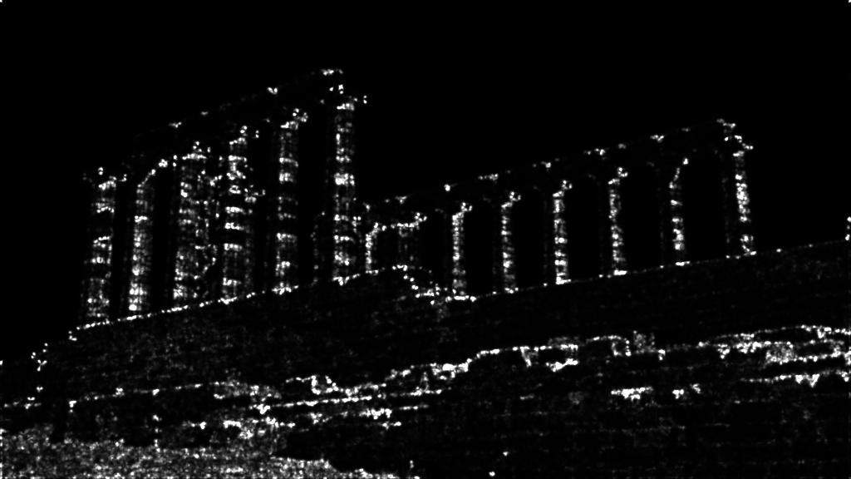
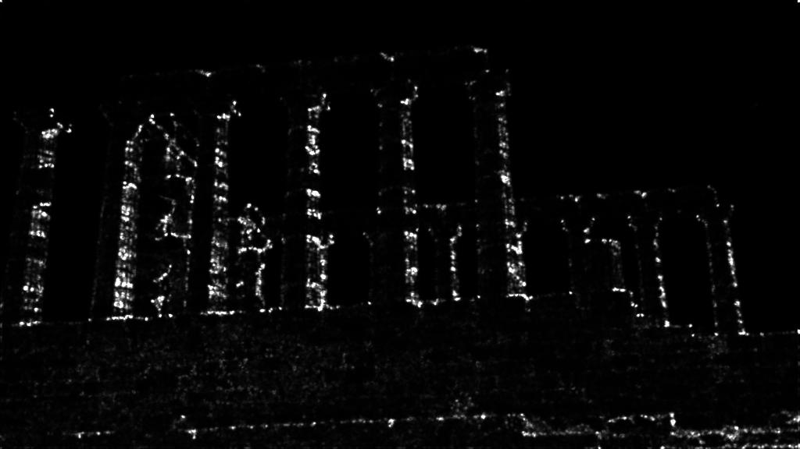
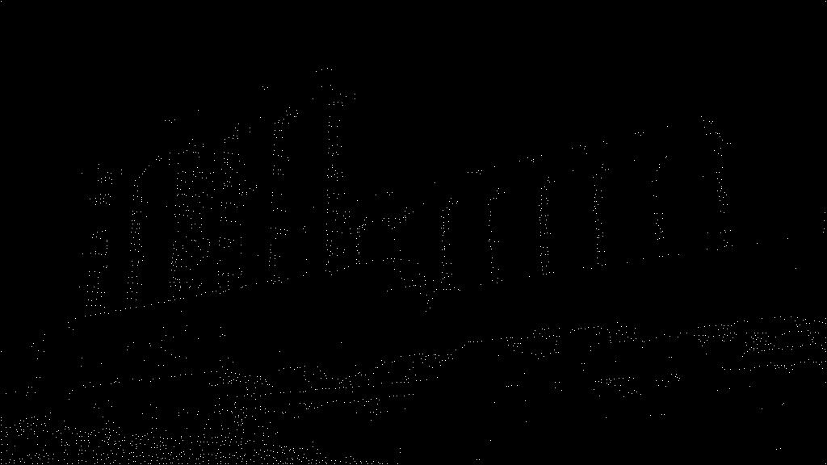
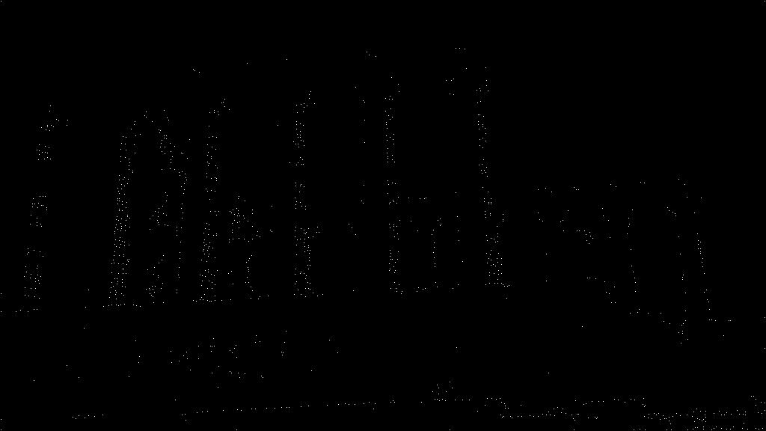


Feature matching
?

Slide 4
Matching with Features
Detect feature points in both images.
Describe them by local statistics.
Find corresponding pairs (Matching).

Slide 5
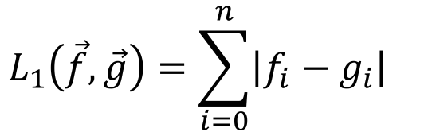
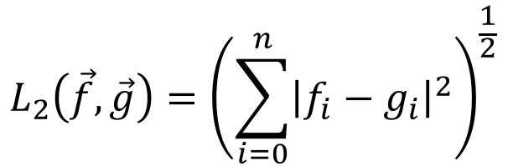
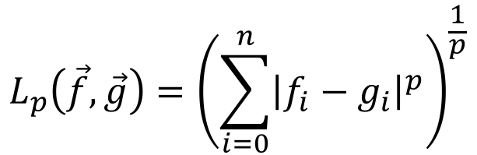
Matching key points
Representation of a key-point by a feature vector.
e.g. [f₀ f₁ … f_{n}]^{T}
Use distance functions / similarity measures.
L₁ norm
L₂ norm
L_{p} norm

Slide 6

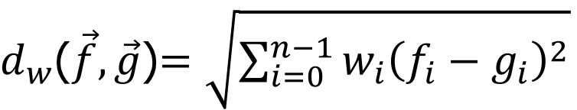
Weighted Distance function
More weights to reliable components.
f , g: Column vectors of dimension n.
A: A +ve semidefinite matrix
Symmetric.
v^{T}Av>=0 for all v.
Typical example: Diag(w₀, w₂, … w_{n-1}), w_{i}>=0

Slide 7
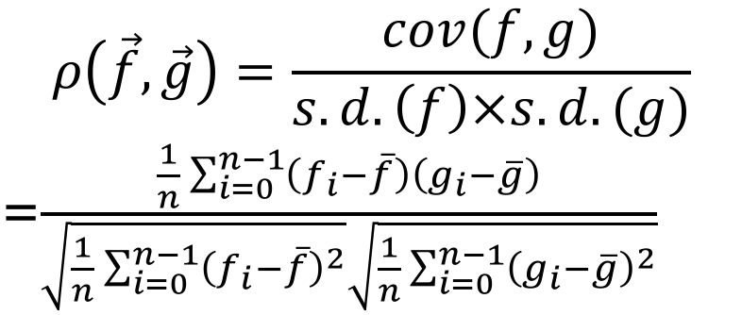
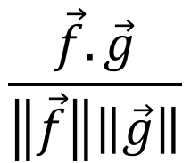
A few other similarity measures
Normalized Cross Correlation- ranges from -1 and 1
Cosine similarity.

Slide 8
Matching criteria
Distance based
Fixed threshold (FT):
Report all matches within the threshold value.
Nearest neighbor (NN):For precisely defining corresponding feature vector
Report the nearest neighbor.
Nearest Neighbor Distance Ratio (NNDR):
Report the NN if ratio of distances between the NN and 2nd NN is small.
Ratio should be vary small, if that is small similarity is high.

Slide 9


Matching criteria
T_{h}
d₁
d₃
d₄
d
2
NNDR: d₃/d₄ (Reject)
NNDR: d₁/d₂ (Accept)

Slide 10
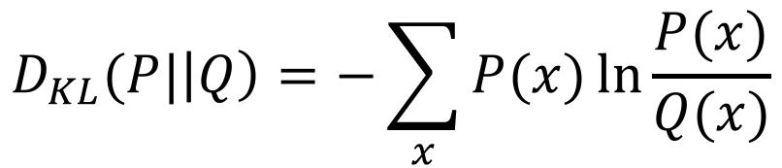
Matching histograms- Deals with region
L_{p} norm of bins (representing same intervals of covariates).
Usually L₁ used.
Kullback-Leiber divergence (of pdf).
Earth Mover’s Distance (EMD)

Slide 11
Earth Mover’s Distance (EMD)
The Earth Mover's Distance (EMD) is a method to evaluate dissimilarity between two multi-dimensional distributions in some feature space where a distance measure between single features, which we call the ground distance is given.

Slide 12
EMD of two histograms P and Q measures the minimum accumulated cost of transferring masses from any bin of P to any bin of Q so that the histogram P gets transformed into Q.
Cost defined by the product of transferred mass and distance between bin.
m x |i-j| for transferring mass m from ith bin of P to jth bin of Q.
This would make P[i]=P[i]-m and Q[j]=Q[j]+m.
Total mass of P and Q should be same.
Accumulated cost is normalized w.r.t. to the total transfer of mass.

Slide 13
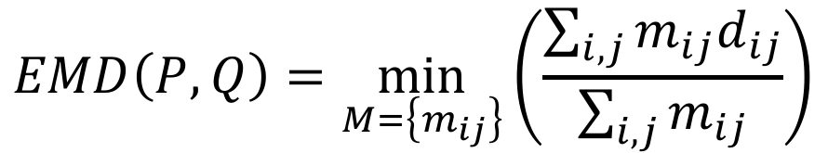

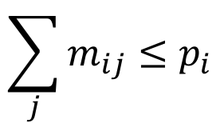
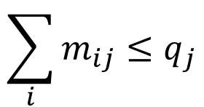
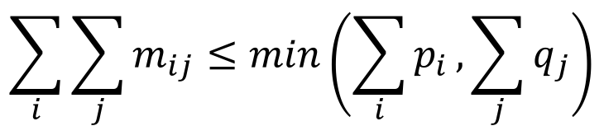
Computing EMD
H. Ling and K. Okada, An Efficient Earth Mover’s Distance Algorithm for Robust Histogram Comparison, IEEE Transactions on Pattern Analysis and Machine Intelligence, 29 (5), pp. 840-853, 2007.
Two normalized histograms:
P={p_{i}} and Q={q_{i}}, for i=0,1,…, N-1.
m_{ij} transferred from i th bin of P to j th bin of Q.
d_{ij} distance between i th and j th bin.
EMD is the minimum normalized work (transfer of masses) required for transforming P into Q.

Slide 14
Computing EMD
H. Ling and K. Okada, An Efficient Earth Mover’s Distance Algorithm for Robust Histogram Comparison, IEEE Transactions on Pattern Analysis and Machine Intelligence, 29 (5), pp. 840-853, 2007.
EMD is the minimum normalized work (transfer of masses) required for transforming P into Q.
Before initiating transfer operation, bins of Q is intialized to zero. The input specificaiton q_{j}’s are used for specifying constraints of the optimization equations.

Slide 15
Efficient computation of feature matching
Range query
Nearest Neighbor of the query.
Report all the features within a distance from the query.
Ordinarily of linear time complexity O(N),
N is the number of features in the target image / database.
Use of indexing and hashing.
K-D Tree
Locality Sensitive Hashing.

Slide 16
K-D Tree
A K-D Tree(also called as K-Dimensional Tree) is a binary search tree where data in each node is a K-Dimensional point in space.
In short, it is a space partitioning data structure for organizing points in a K-Dimensional space.
A non-leaf node in K-D tree divides the space into two parts, called as half-spaces. Points to the left of this space are represented by the left subtree of that node and points to the right of the space are represented by the right subtree.

Slide 17
K-D tree
A binary tree.
Each node contains a (key) feature vector.
Each node behaves like a node of binary search tree (BST) for values of a particular dimension
Called cut-dimension.
Alternate periodically on nodes along any path.
Places a key feature vector following the rules of BST comparing on the value of the cut-dimension.

Slide 18
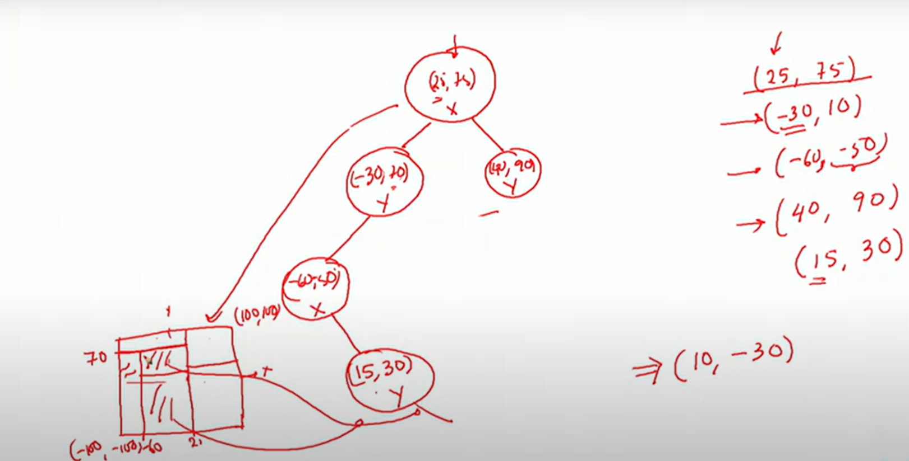

Slide 19
NN Search using K-D tree
As you walk through the tree nodes
Store the current smallest distance and the respective key-feature.
Prune sub-trees by comparing the minimum distance with the corner nodes of the hypervolume (bounding boxes) represented by the sub-tree.
Search the sub-tree to maximize the chance of pruning.
Go to the sub-tree closer to the query.

Slide 20
NN Search using K-D tree
May require to traverse all the nodes of the tree.
Worst case: O(N)
In practice close to: O(log(N)+2^{d}), where d is the dimension of the feature space.
log(N) to find the cell near the query point.
2^{d} search around cells in the neighborhood.

Slide 21
Local Sensitive Hashing (LSH)
Local Sensitive Hashing (LSH) is a set of methods that is used to reduce the search scope by transforming data vectors into hash values while preserving information about their similarity.

Slide 22
Locality sensitive hashing (LSH)
Locality preserving hashing function (h(.)) w.r.t a distance function d(.).
Prob.(h(x)=h(y)) should be high, if d(x,y) is small,
else the probability should be small.
#Property: You have to use hash function which should preserves the locality of feature vectors w.r.t distance function.

Slide 23
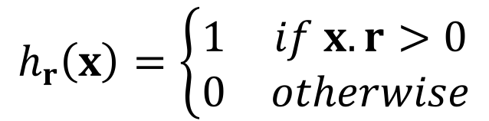
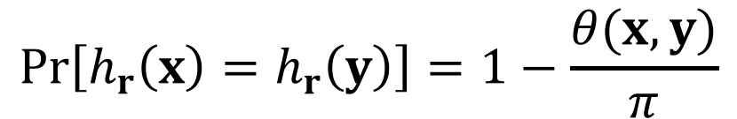
LSH: A typical example
Choose a random unit vector r of dimension n (e.g. following Normal distribution (N(0,1)) independently in each dimension).
For any vector x of dimension n define a hash function as follows:
It can be shown, for any x and y
Angle between
x and y.

Slide 24
LSH multidimenstional bucketing
You may also have a set of k random vectors independently generating k hash values, and define the multidimensional bucket for hashing to place the input vector.
H(x)=[h_{r1}(x) h_{r2}(x) …. h_{rk}(x)]
You may have L multiple buckets (corresponding to L sets of k random vectors) for the same input.
H₁(x), H₂(x), …, H_{L}(x)
Given a query y compute L buckets and search for NN in all of them.

Slide 25
Model fitting
Given a set of data points fit a model to establish relationship among the data points.
Homography matrix between pixels in two images of the same planar scene.
Fundamental matrix between corresponding points in two stereo images.
Given a set of 2-D points fit a straight line / parabolic curve / circle / a high degree polynomial curve passing through them.
Obtain data points and fit appropriate model.
Preprocessing, feature detection-description-matching.

Slide 26
Knowledge of models
Mathematical form of the class / family of Models.
3x3 non-singular homography matrix for projective transformation.
3x3 singular fundamental matrix for stereo geometry.
3x4 Projection matrix.

Slide 27
Choice of a model
Error of fitting
Mean square error (diff. b/w predicted and observed data)
Likelihood
Pr (Data | Model)
Size of a model
Number of independent parameters (more parameters more complex model)
Training and Test Error
Large training error: Under-fitting (no. of parameters in model are less)
Low training error, but large test error: Over-fitting (Data Specific)
Low training and test error: A good fit.

Slide 28
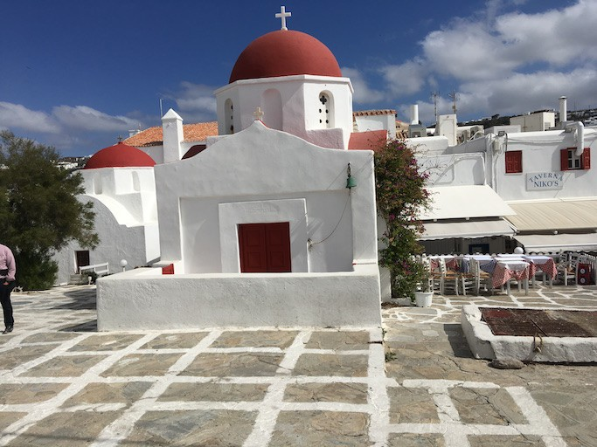
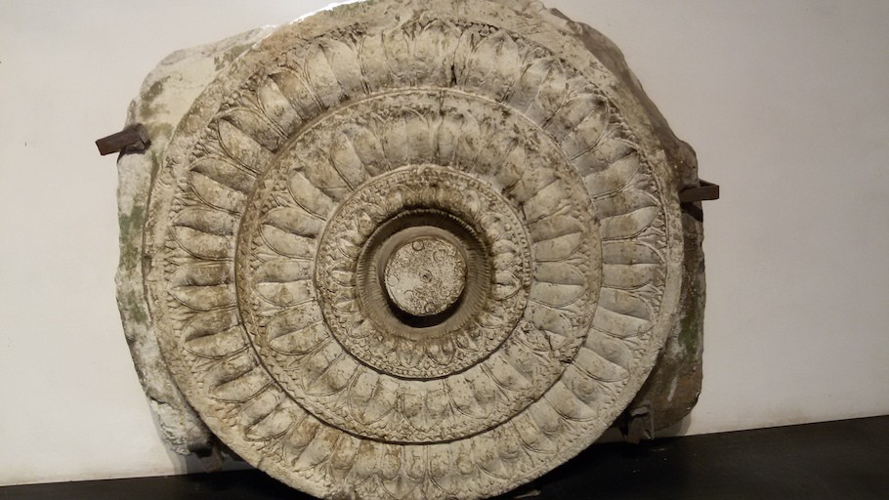
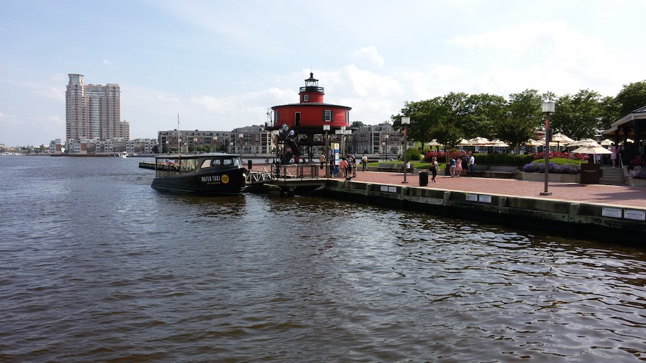
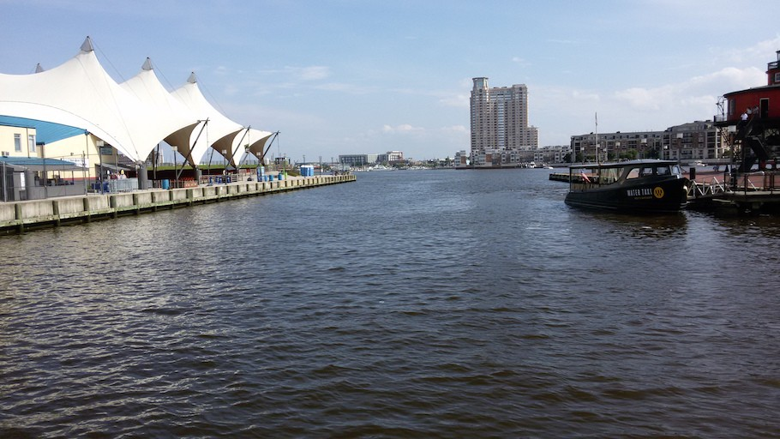
Fitting curves and lines
simple model: lines simple model: circles
To decide about appropriate parametric models.
complicated model: Steam-boat

Slide 29
Various Issues
Noise / Error
in estimation of feature locations.
Extraneous data
clutter (outliers), multiple lines.
Missing data
Occlusions (Partial information)

Slide 30
Fitting a straight line over 2D points
Fitting techniques
Least Squares
Total Least Squares
Random Sample Consensus (RANSAC)
Hough Voting

Slide 31
Line fitting in varying contexts
Given points belonging to a line, to find the “optimal” line parameters.
Least squares
To handle outliers.
RANSAC
Presence of many lines.
Voting methods: Hough transform
Adapted from slides by S. Lazebnik.

Slide 32
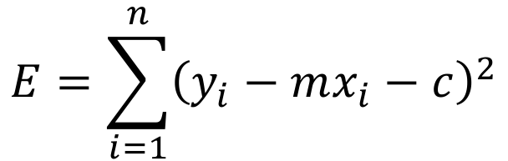
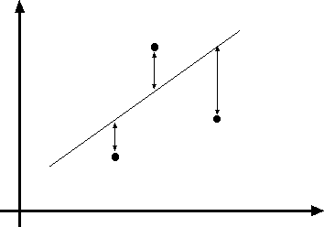
Least squares line fitting
“Vertical” least squares
y=mx+c
Data:
(x₁, y₁), …, (x_{n}, y_{n})
Line equation:
y_{i} = m x_{i} + c
Find (m, c) to minimize
(x , y )
i i
Adapted from slides by S. Lazebnik.

Slide 33

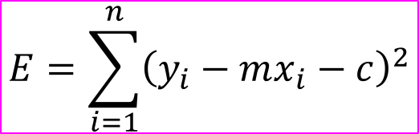
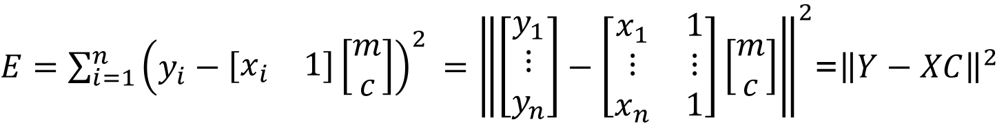
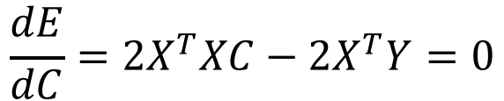

y=mx+c
Least squares line fitting
Data: (x₁, y₁), …, (x_{n}, y_{n})
Line equation: y_{i} = m x_{i} + c
Find (m, c) to minimize
(x_{i}, y_{i})
Adapted from slides by S. Lazebnik.

Slide 34

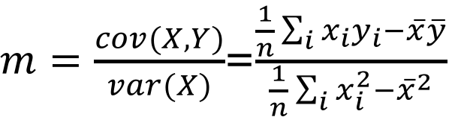


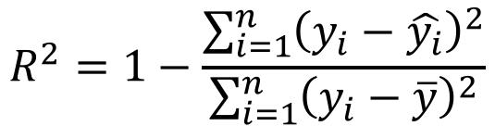
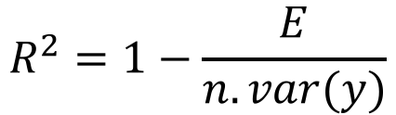
y=mx+c
Least squares line fitting
(x_{i}, y_{i})
The R² goodness-of-fit criterion compares the variability in the measurements not explained by the model to the total variability in the measurements.
Goodness of fit:
Not rotation-invariant.
Fails completely for vertical lines.
Variance
Adapted from slides by S. Lazebnik.

Slide 35
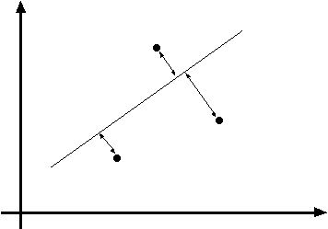
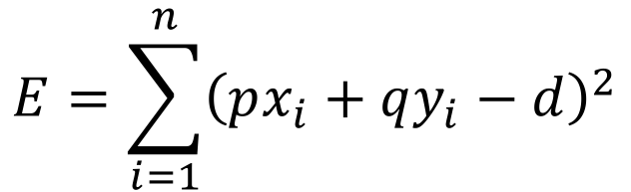
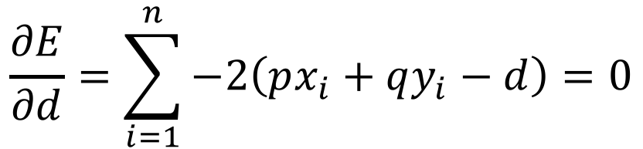
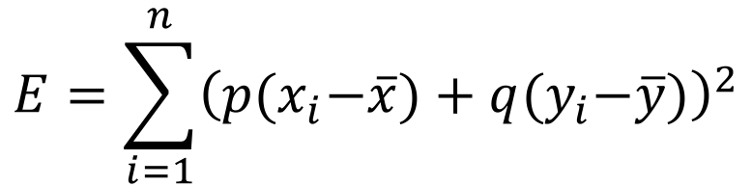

Total least squares
Distance between a point (x_{i}, y_{i}) and the line
px+qy=d : |px_{i} + qy_{i} – d| given p²+q²=1.
px+qy=d
Unit normal:
(x_{i}, y_{i})
N=(p, q)
E = ∑₌ (ax + by − d )
n ₂
_{i 1} i i
Adapted from slides by S. Lazebnik.

Slide 36
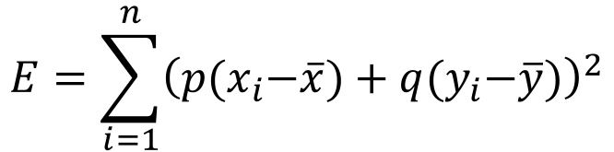
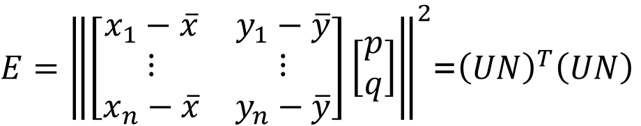
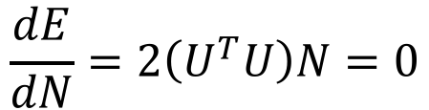
Total least squares
px+qy=d
Unit normal:
U
(x_{i}, y_{i})
N=(p, q)
E = ∑₌ (ax + by − d )
n ₂
_{i 1} i i
N
Subject to ||N||=1.
Eigen vector of U^{T}U corresponding to the smallest eigen value.
Adapted from slides by S. Lazebnik.

Slide 37
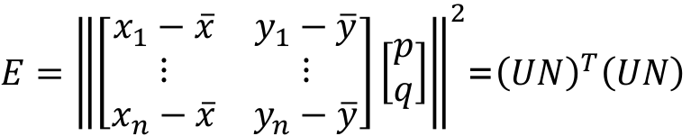

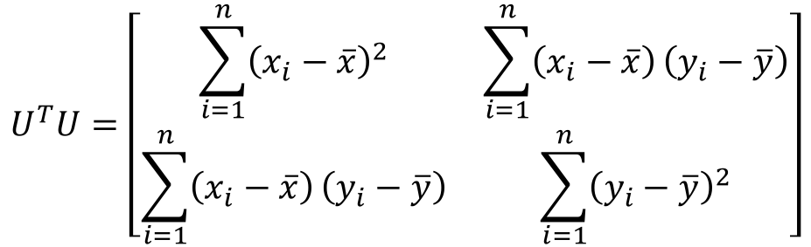
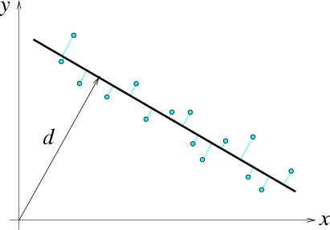
Total least squares
px+qy=d
Unit normal:
Subject to ||N||=1.
(x_{i}, y_{i})
N=(p, q)
E = ∑₌ (ax + by − d )
n ₂
_{i 1} i i
N = (p, q)
(x_{i} − x, y_{i} − y)
(x, y)
Eigen vector of U^{T}U corresponding to the smallest eigen value.
Adapted from slides by S. Lazebnik.

Slide 38
Random sample consensus (RANSAC)
A general framework for model fitting in the presence of outliers.
Outline
Choose a small subset of points uniformly at random.
Fit a model to that subset.
Find all remaining points that are “close” to the model and reject the rest as outliers.
Do this many times and choose the best model.
M. A. Fischler, R. C. Bolles. Random Sample Consensus: A Paradigm for Model Fitting with Applications to Image Analysis and Automated Cartography. Comm. of the ACM, Vol 24, pp 381-395, 1981.
Adapted from slides by S. Lazebnik.

Slide 39
RANSAC for line fitting
Perform the following N times:
Select s points uniformly at random.
Fit a line using the LSE method.
Find inliers to this line
points whose distance from the line is less than t.
For sufficient number of inliers (say > d), accept the line and refit using all inliers.
Adapted from slides by M. Pollefeys

Slide 40
Choice of parameters
Adapted from slides by M. Pollefeys
Initial number of points s
Typically minimum number needed to fit the model.
Distance threshold t
Choose t so probability for inlier is p (e.g. 0.95).
Zero-mean Gaussian noise with std. dev. σ: t=1.96σ.
Number of trials N
Choose N so that, with probability p, at least in one trial random selections are free from any outlier. (e.g. p=0.99) (outlier ratio: e).
Consensus set size d
n=No. of data points
Should match expected inlier ratio: (1-e) x n.

Slide 41
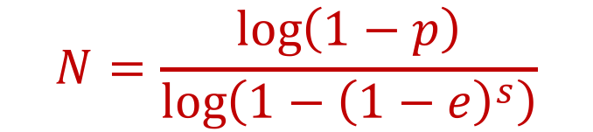
Estimating number of trials N
Prob. that a sample is outlier.
Outlier ratio: e
Prob. that all s samples are inliers: (1- e)^{s}
Prob. that at least one sample is an outlier in a
trial:
(1- (1- e)^{s})
Prob. that all N trials have an outlier:(1- (1- e)^{s})^{N}
Given probability p, so that at least one random
sample is free from outliers.
(1- (1- e)^{s})^{N}=1-p
Adapted from slides by M. Pollefeys

Slide 42
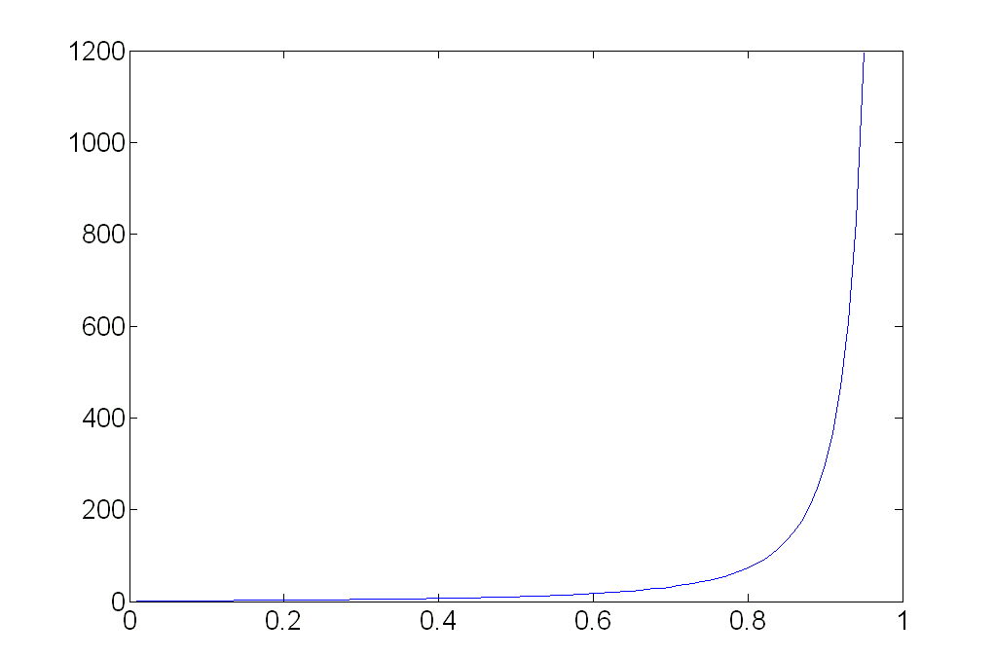
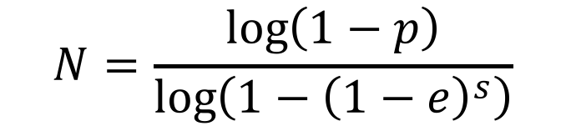
Choosing N
N
e
p=0.99
proportion of outliers e
s | 5% | 10% | 20% | 25% | 30% | 40% | 50%
2 | 2 | 3 | 5 | 6 | 7 | 11 | 17
3 | 3 | 4 | 7 | 9 | 11 | 19 | 35
4 | 3 | 5 | 9 | 13 | 17 | 34 | 72
5 | 4 | 6 | 12 | 17 | 26 | 57 | 146
6 | 4 | 7 | 16 | 24 | 37 | 97 | 293
7 | 4 | 8 | 20 | 33 | 54 | 163 | 588
8 | 5 | 9 | 26 | 44 | 78 | 272 | 1177
Adapted from slides by M. Pollefeys

Slide 43
RANSAC pros and cons
Pros
Simple and general
Applicable to many different problems
Often works well in practice
Cons
Many parameters to tune
Can’t always get a good initialization of the model based on the minimum number of samples
Sometimes too many iterations are required
Not appropriate for low inlier ratio.
Adapted from slides by M. Pollefeys

Slide 44
Voting schemes
Let each feature vote for all the models that are compatible with it.
Hopefully the noise features will not vote consistently for any single model
Missing data doesn’t matter as long as there are enough features remaining to agree on a good model.

Slide 45
Hough transform
Discretize parameter space into bins
For each feature point in the image, put a vote in every bin in the parameter space that could have generated this point.
Find bins that have the most votes.
y=mx+b
m
b
Image space
Hough parameter space
P.V.C. Hough, Machine Analysis of Bubble Chamber Pictures, Proc. Int. Conf. High Energy Accelerators and Instrumentation, 1959

Slide 46

Parameter space representation
A straight line in the image corresponds to a point in Hough space.
Image space
Hough parameter space
y
b
y=m₁x+b₁
(m₁,b₁)
x
m
Adapted from slides by S. Seitz

Slide 47

Parameter space representation
A point in the image corresponds to a line in the Hough space.
Image space
Hough parameter space
b
y
b=-x₁m+y₁
(x₁,y₁)
m
Adapted from slides by S. Seitz
x

Slide 48

Parameter space representation
Two points in the image correspond to two lines in the Hough space.
Image space
Parameters of straight line
joining these b
two points.
Hough parameter space
y
(x₂,y₂)
(x₁,y₁)
b=-x₁m+y₁
b=-x₂m+y₂
m
Adapted from slides by S. Seitz
x

Slide 49
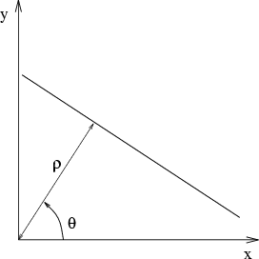
Parameter space representation
Problems with the (m,b) space:
Unbounded parameter domain
Vertical lines require infinite m
Alternative: polar representation
x cosθ
y sinθ = ρ
θ varies from 0 to 180º
ρ varies from 0 to the length of diagonal of the image grid.
Each point will add a sinusoid in the (θ,ρ) parameter space
Adapted from slides by S. Seitz

Slide 50
Algorithm
Initialize accumulator A to all zeros
For each edge point (x,y) in the image
{
For θ = 0 to 180
{
ρ = x cos θ + y sin θ A(θ, ρ) = A(θ, ρ) + 1
}
}
A: Accumulator array
ρ
•
θ
Find the value(s) of (θ, ρ) where A(θ, ρ) is a local maximum
The detected line in the image is given by
ρ = x cos θ + y sin θ
Adapted from slides by S. Seitz

Slide 51
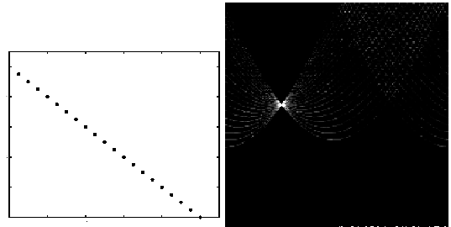
Basic illustration
features
votes
http://ostatic.com/files/images/ss_hough.jpg

Slide 52
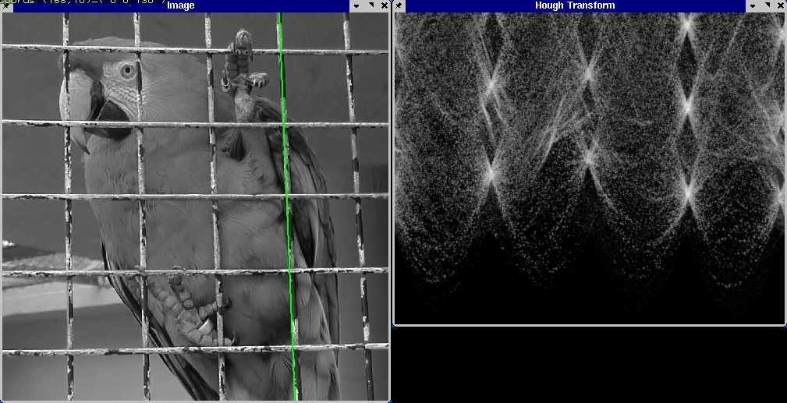
A more complicated image
http://ostatic.com/files/images/ss_hough.jpg

Slide 53

Effect of noise
features
votes
http://ostatic.com/files/images/ss_hough.jpg

Slide 54
Dealing with noise
Requires appropriate resolution of discretization of the grid in the parameter space
Too coarse:
large votes in a cell for accumulating too many different lines correspond to a single bucket
Too fine:
may miss lines as some points may not be exactly collinear voting different buckets.

Slide 55
Dealing with noise
Smoothing accumulator array.
Try to get rid of irrelevant features
Take only edge points with significant gradient magnitude

Slide 56
Summary
Feature matching.
Distance function / Similarity measure.
Different policies
Use of a threshold value.
Nearest Neighbor.
Nearest neighbor with distance ratio (NNDR).
Use of indexing / hashing for efficient computation.
Special distance functions for comparing histograms.
Kullback-Leiber Divergence (KLD)
Earth Mover’s Distance (EMD)

Slide 57
Summary
Model fitting
Prior knowledge of the model useful.
Need to consider goodness of fit.
Different techniques for line fitting
Least squares
Total least squares.
RANSAC
Hough Transform.

